Slide 1
Bazele inteligenței artificiale
Laborator – Grigore Ionuț

Slide 2


today’s lab

Slide 3


Slide 4
Content
The curse of dimensionality - intro
Principal component analysis (PCA)
Locally linear embedding (LLE)
t-Distributed stochastic neighbor embedding (t-SNE)

Slide 5
1) The curse of dimensionality

Slide 6

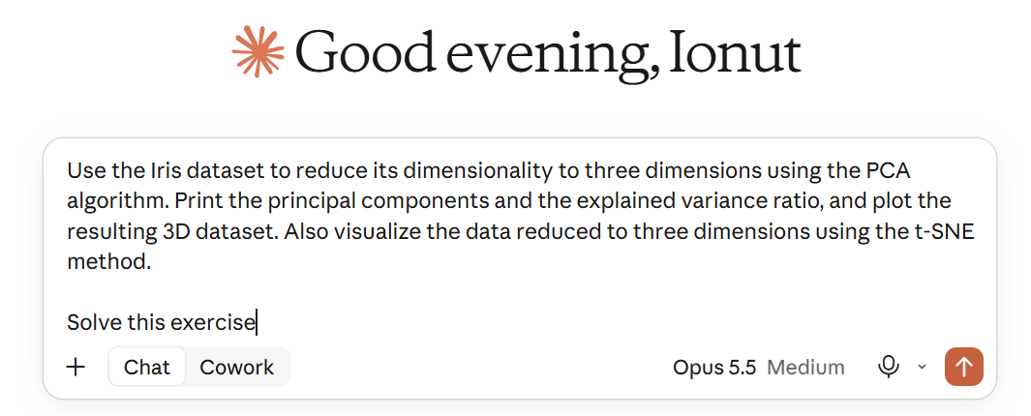
Many ML tasks use thousands or even millions of features per instance:
224 × 224 × 3 pixels
Use the Iris dataset to reduce its dimensionality …
150,528 features
…
…
…
…
vectors of 4,096 elements each

Slide 7
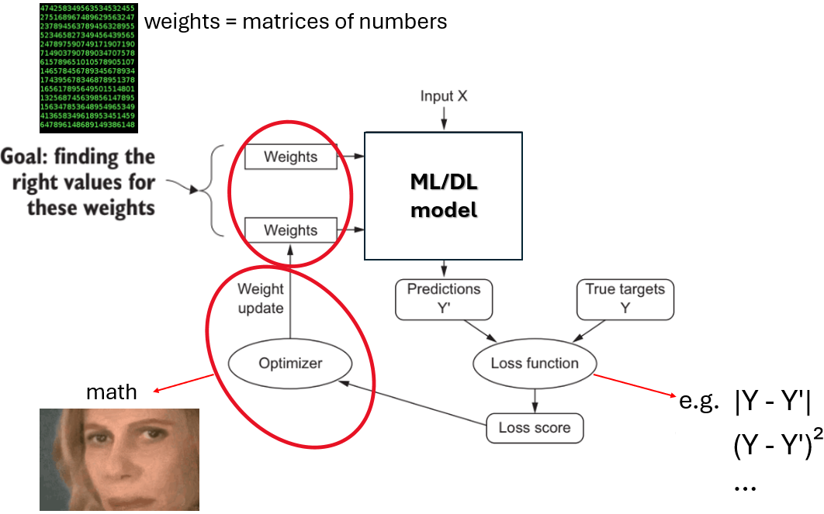
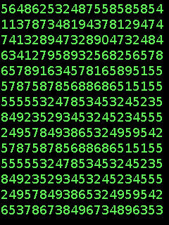


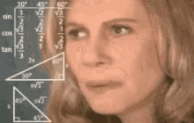
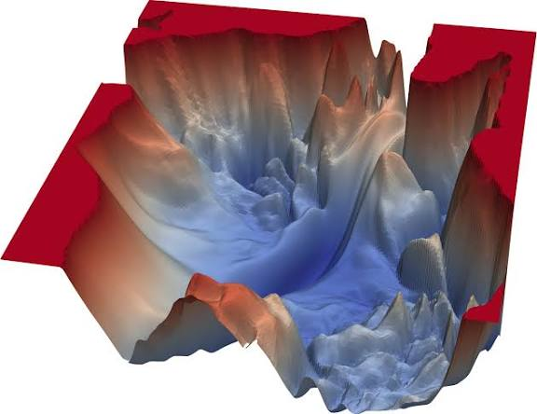

All these features:
make training extremely slow
“Where minimum?”
make it much harder to find a good solution
Loss function

Slide 8
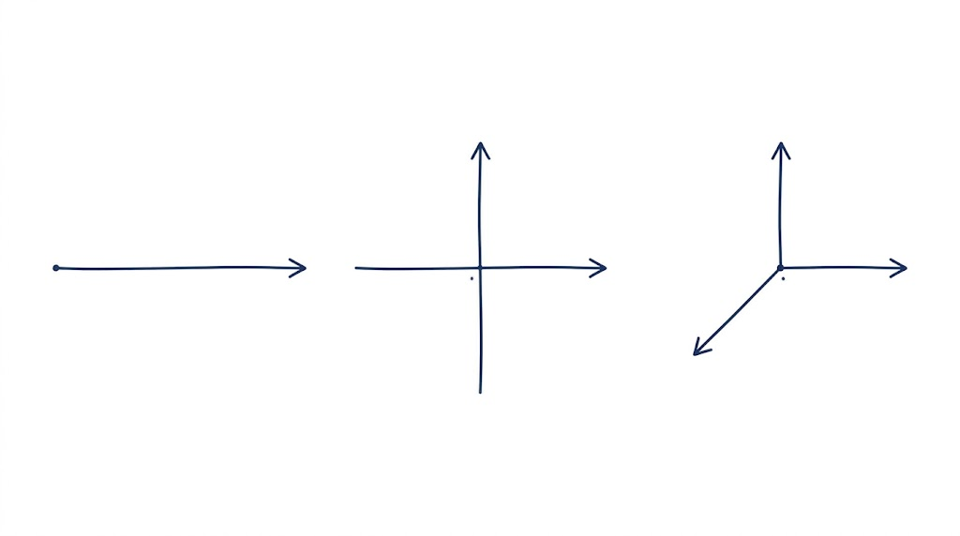
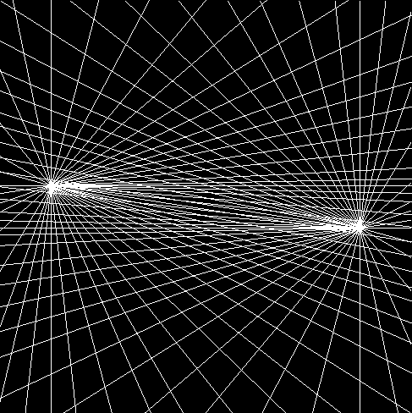




make data impossible to visualize beyond 3D
1D
2D
3D
ND
Y
Y
…
O
X
O
X
O
X
Z

Slide 9

The curse of dimensionality !

Slide 10
Solution ?

Slide 11

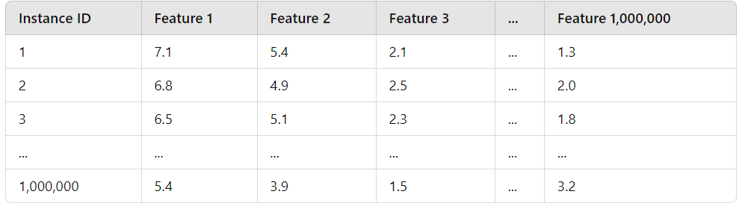
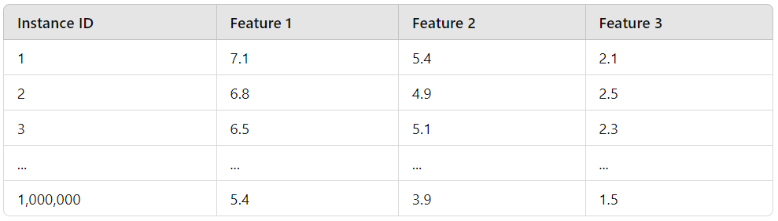

Slide 12
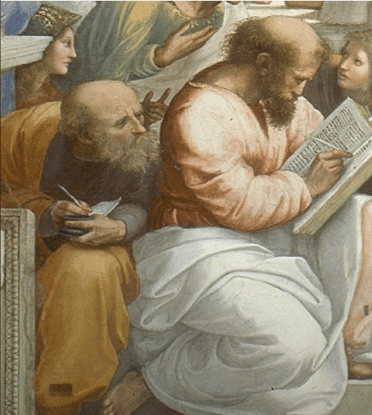
Life is better with an example…

Slide 13
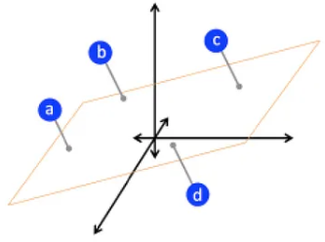
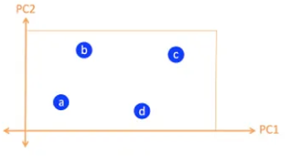

3D
2D
1D
https://www.youtube.com/watch?v=pAwjiGkafbM

Slide 14
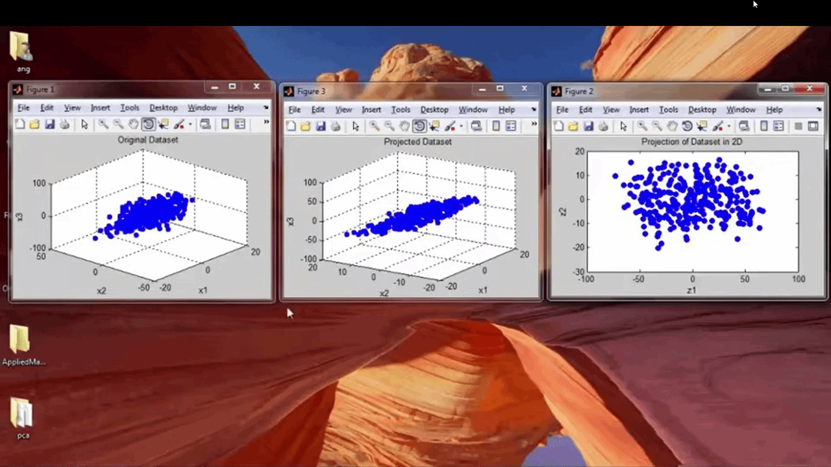

Slide 15
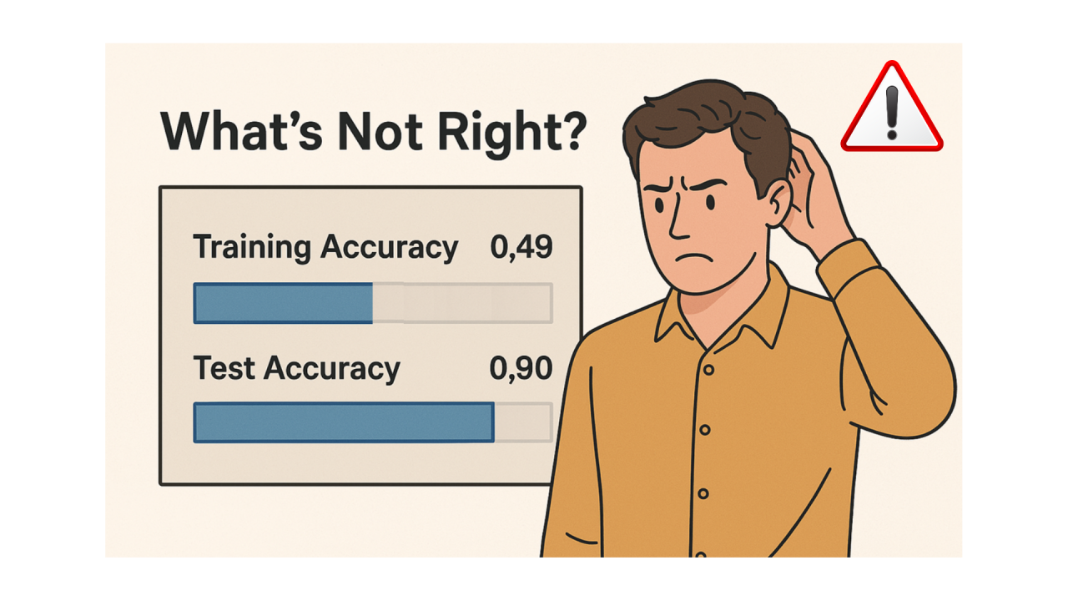


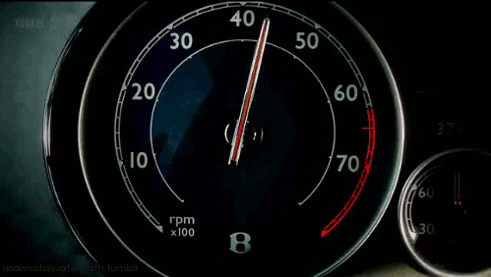

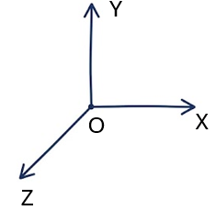
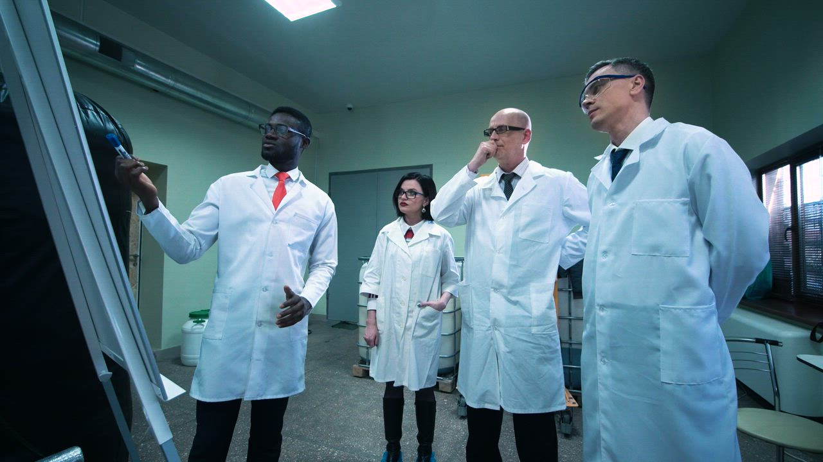
In real world problems it’s often possible to reduce the number of features considerably:
some information loss a slightly worse performance
Old accuracy: 92%
New accuracy: 91%
speed up training
data visualization reducing to 2 or 3 dimensions, we can plot the data and gain some insights about the it
ND
3D

Slide 16
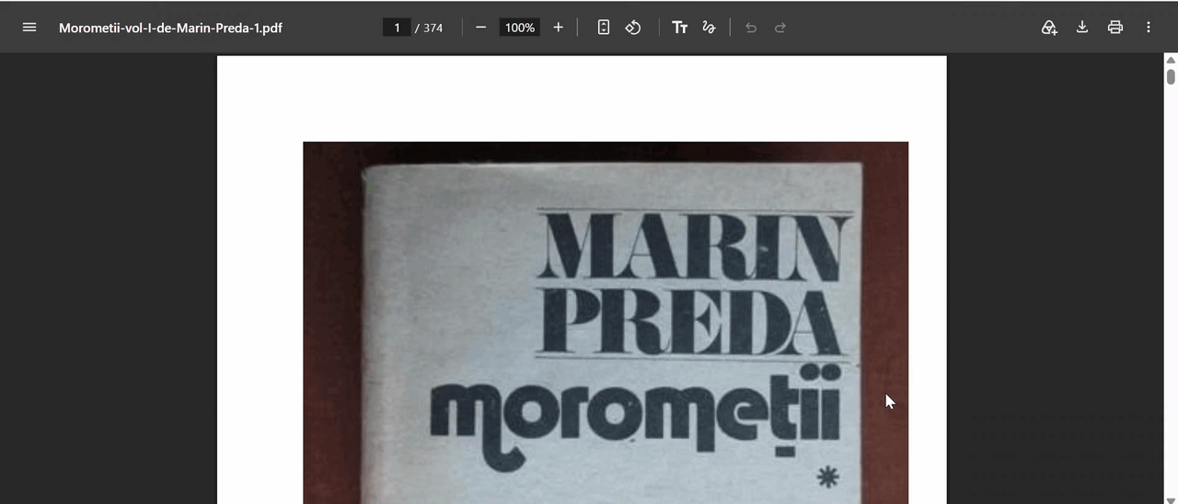
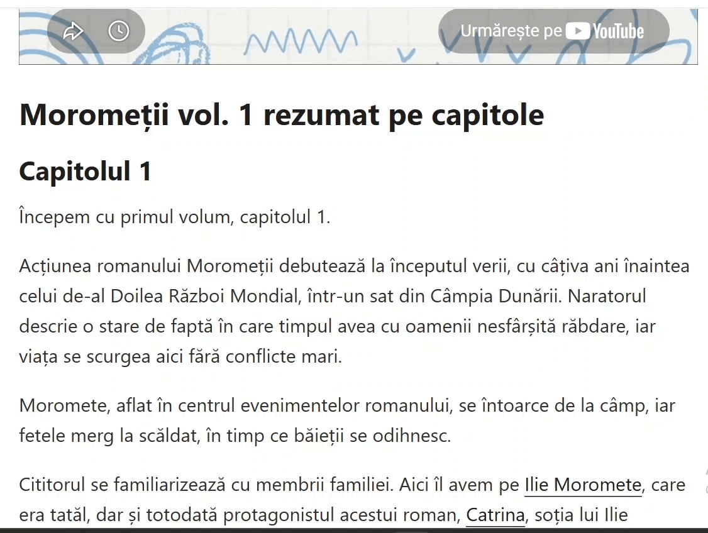

Slide 17
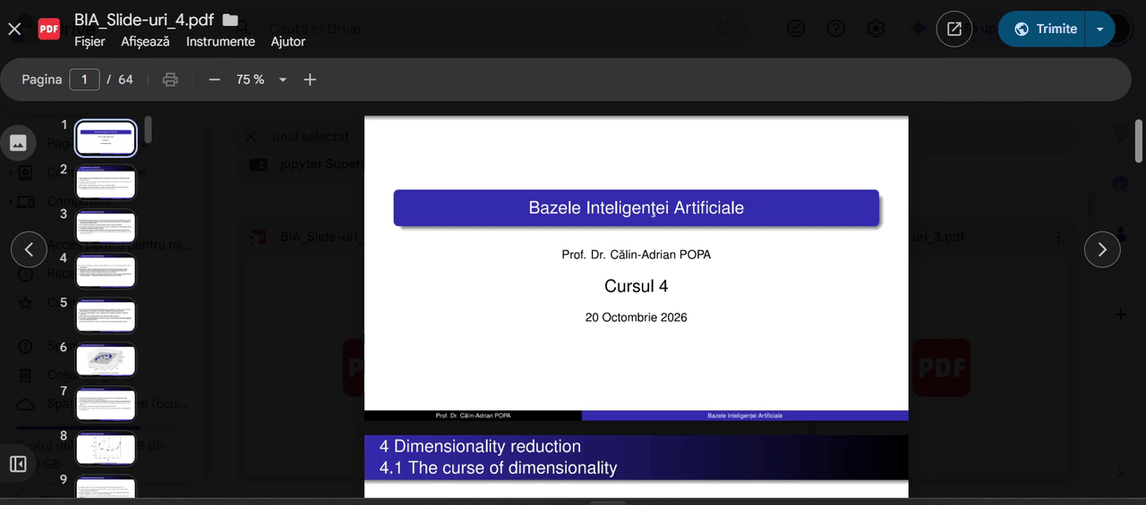

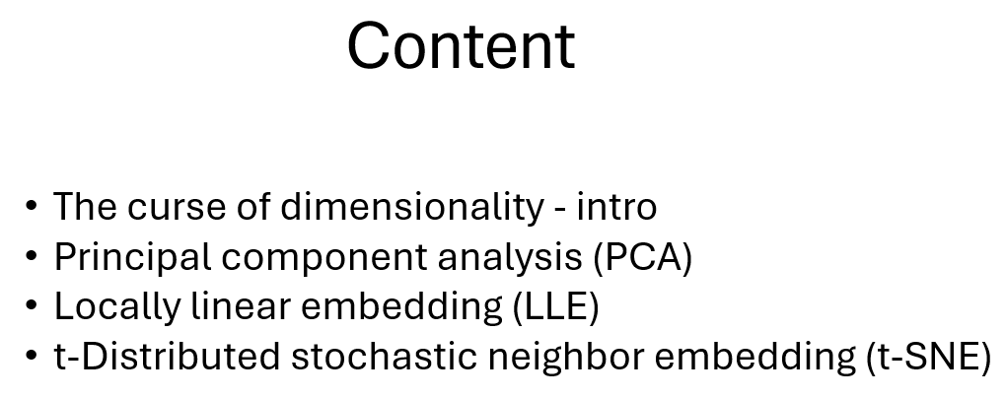

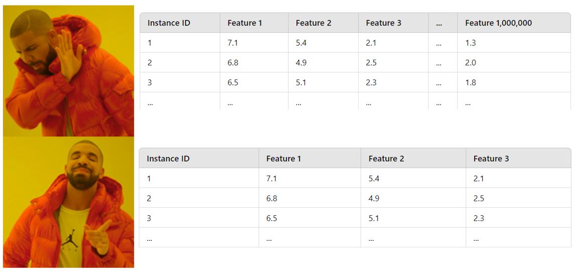


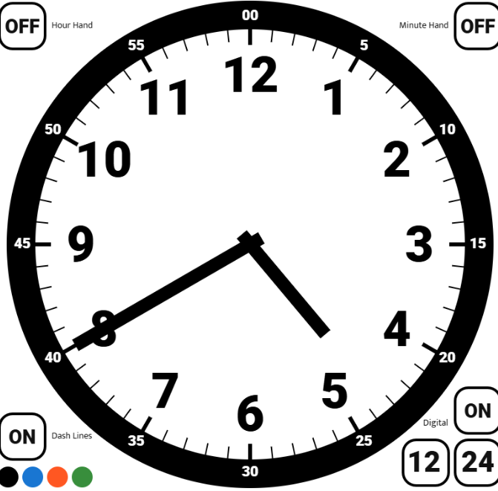


16:00
…
16:40

Slide 18
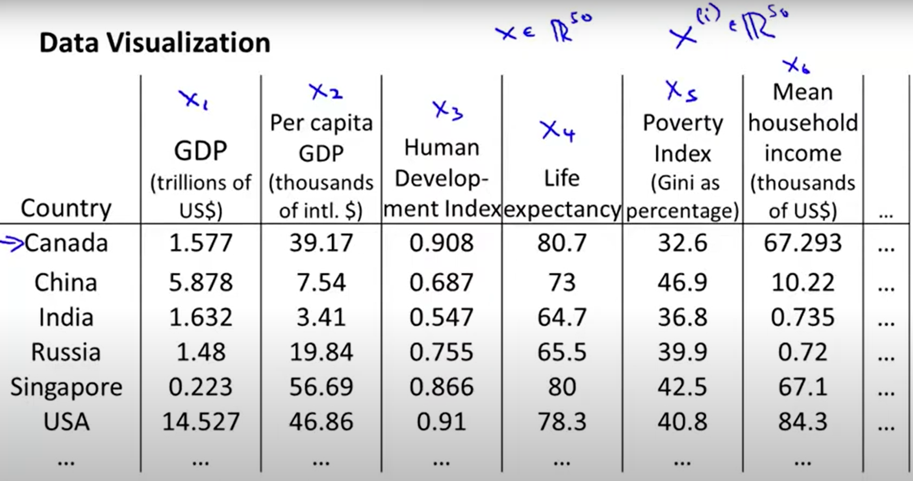
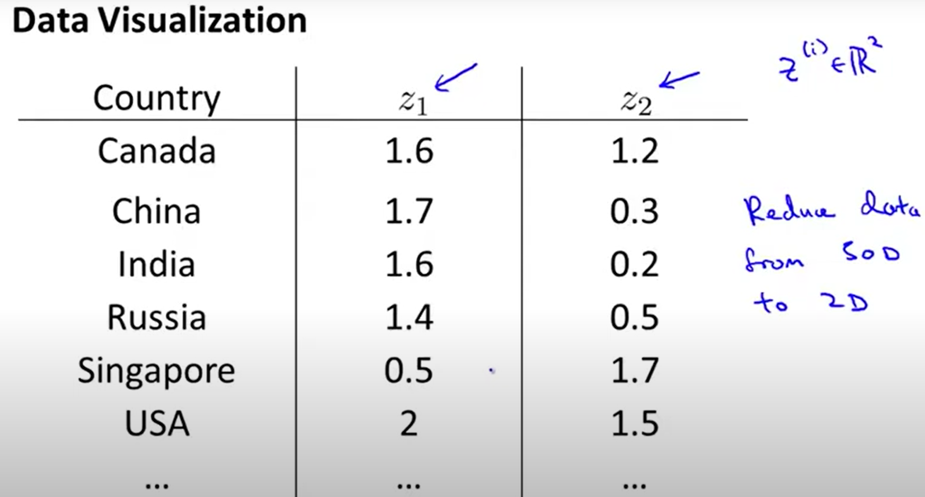
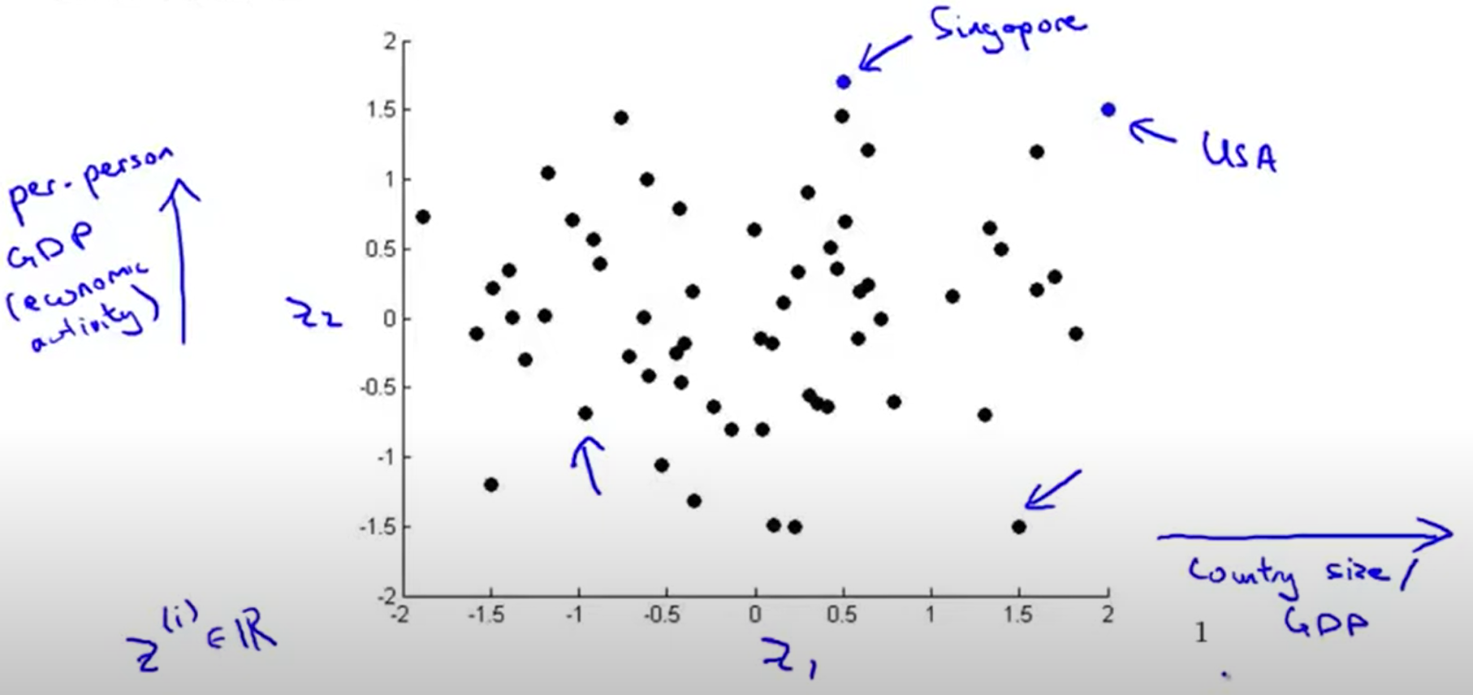
NOTE:
the dimensionality reduction algorithm usually doesn’t describe a particular meaning to these new features z₁ and z₂
it’s often up to us to figure out roughly what these features means
we might find for example that the z₁ axis corresponds roughly to the overall country size or the overall economic activity (GDP) whereas the z₂ axis may correspond to per person economic activity

Slide 19
2) Principal component analysis (PCA)

Slide 20
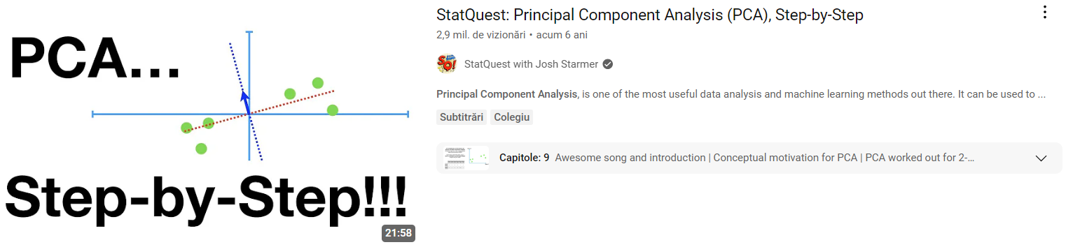
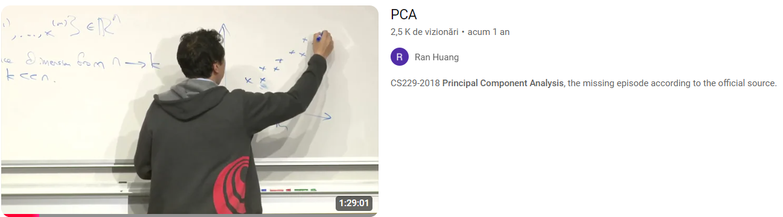

Slide 21
GENERAL IDEA: identify the hyperplane that lies closest to the data and then projects the data onto it

Slide 22


Slide 23
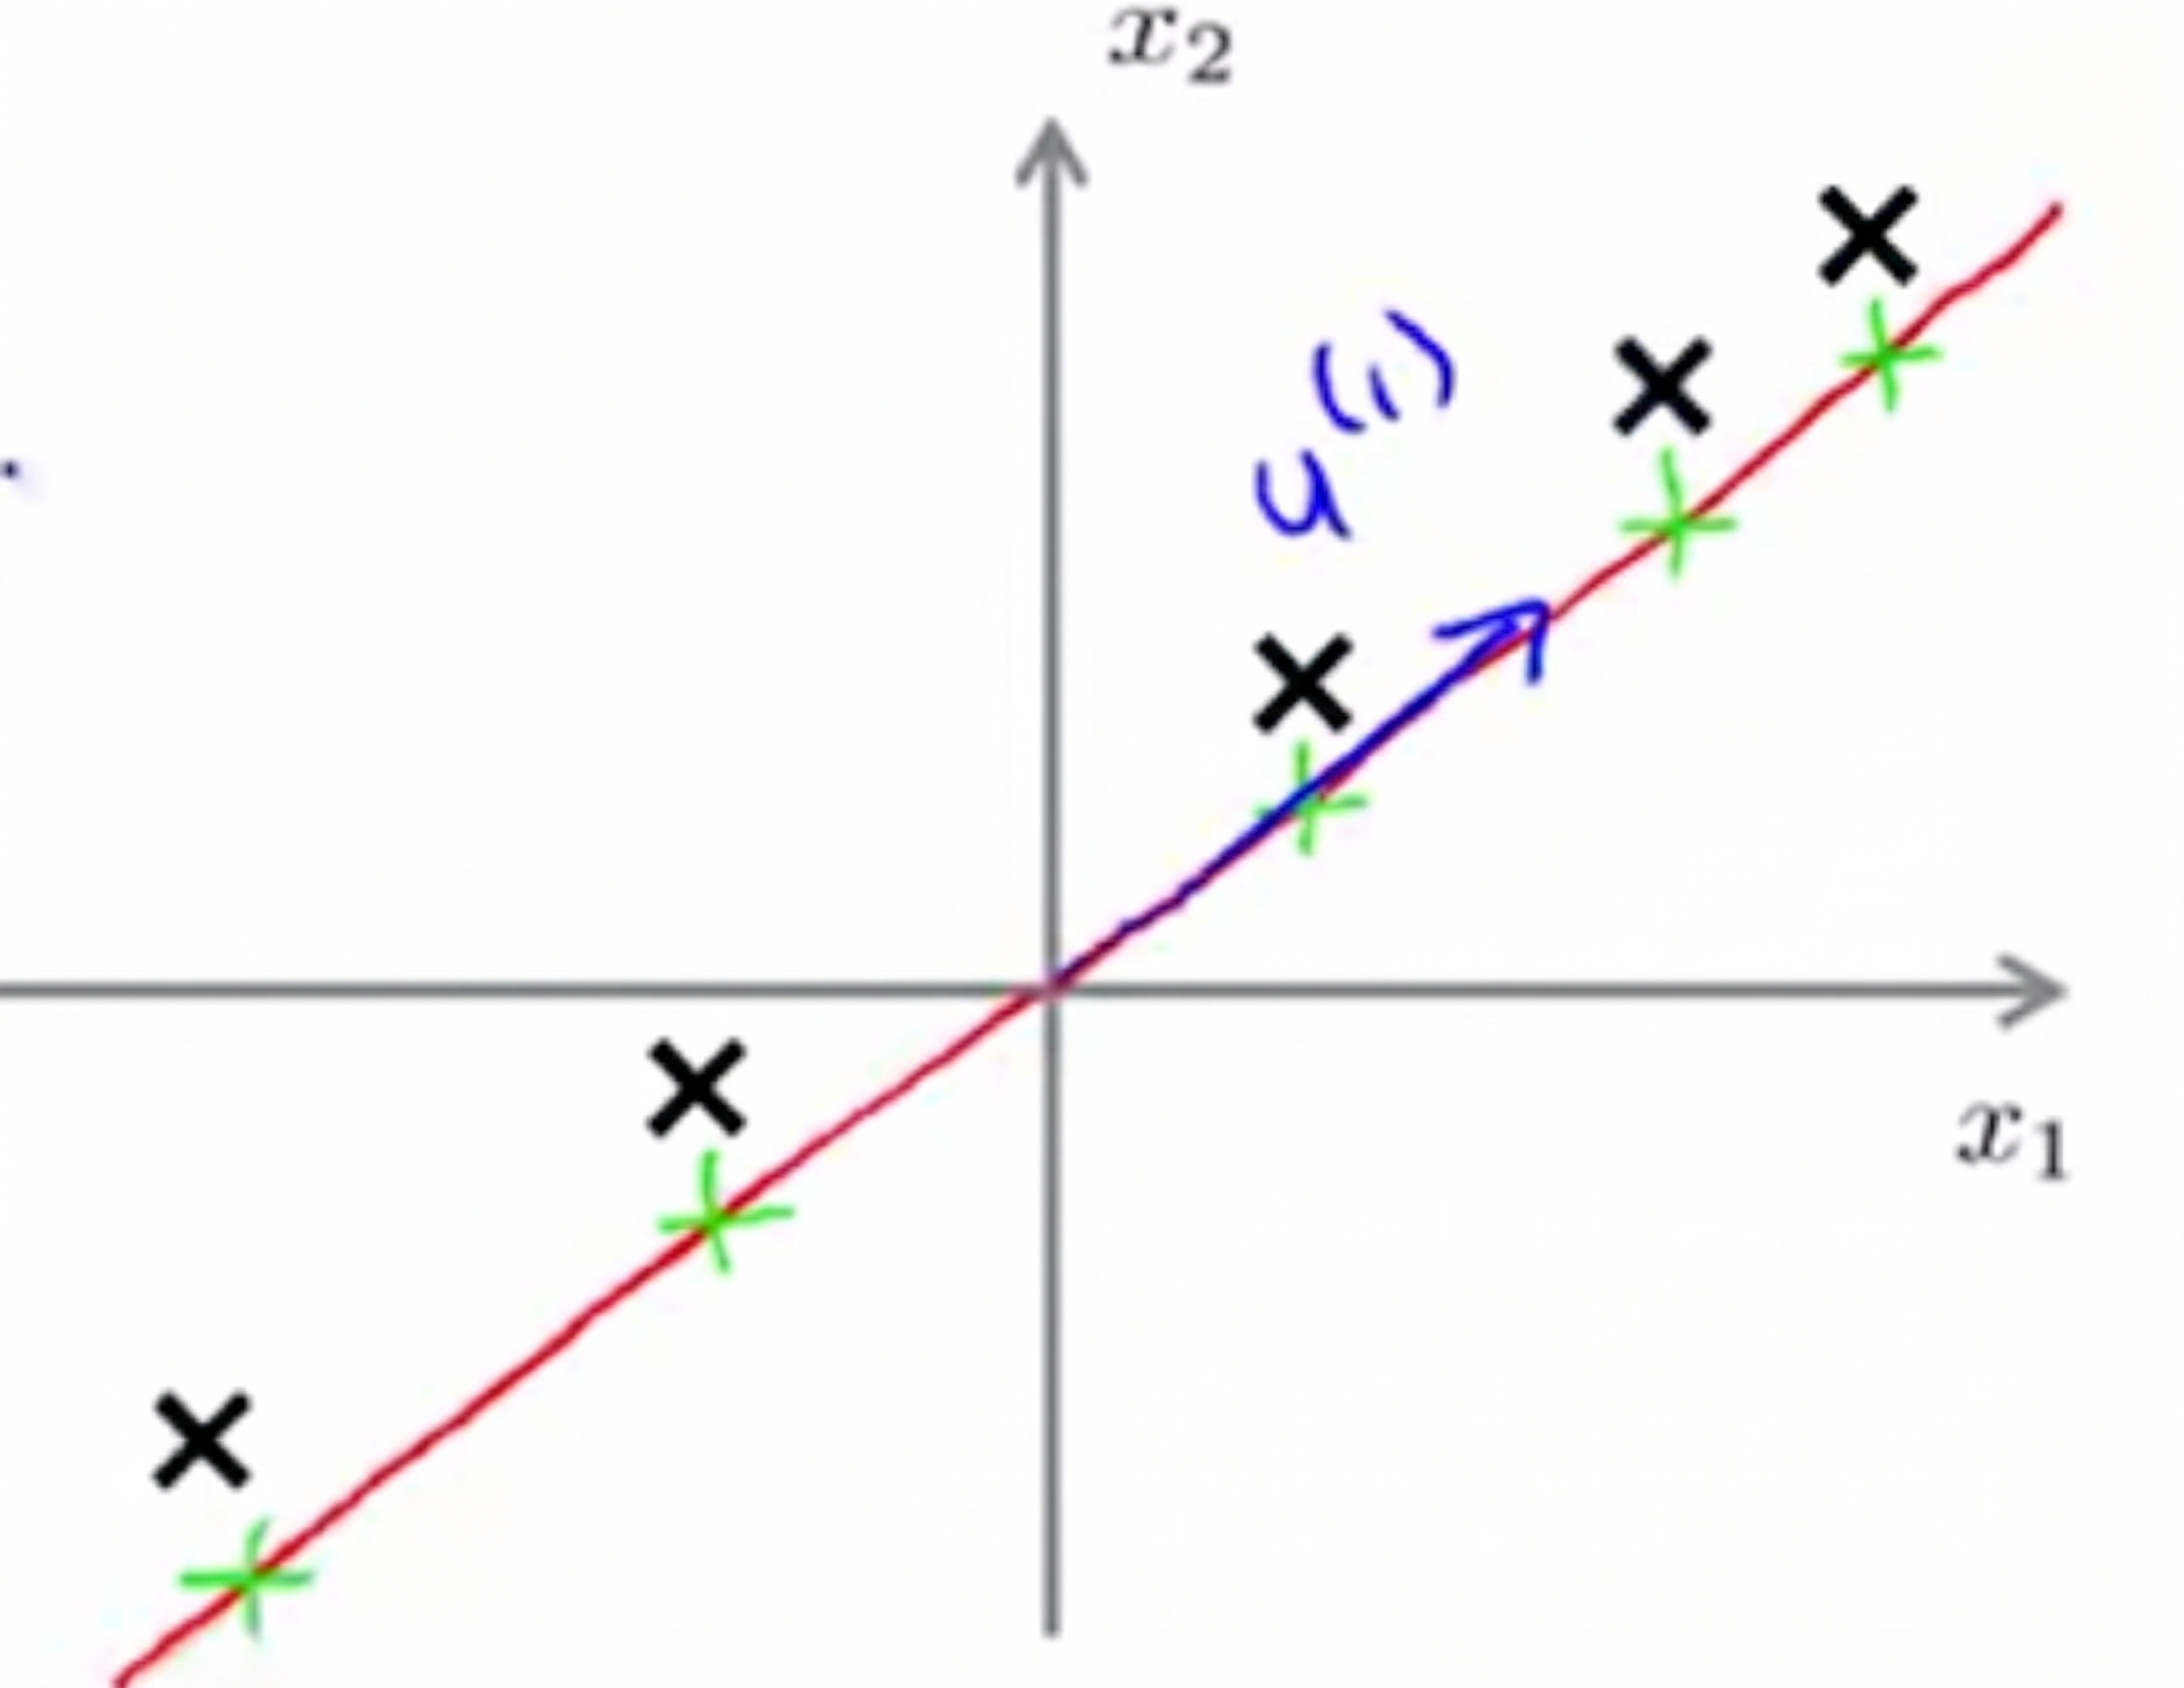

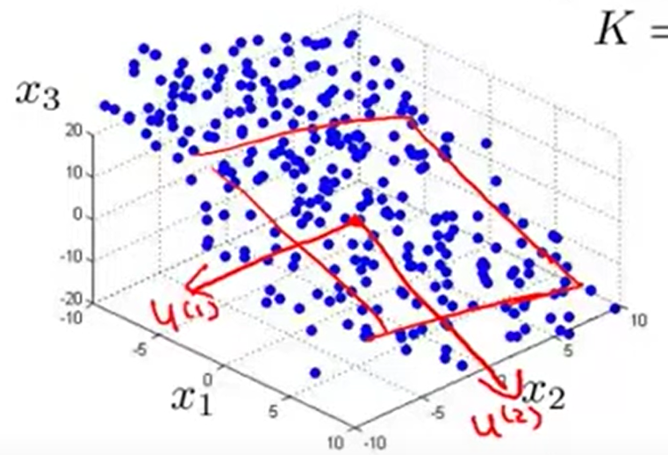
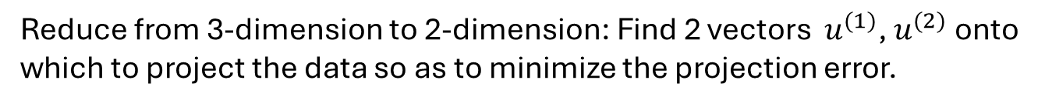
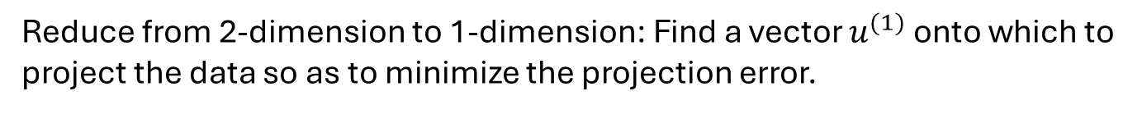
×
×
×
Reduce from 2-dimension to 1-dimension: Find a vector $u^{(1)}$ onto which to project the data so as to minimize the projection error.
×
×
Reduce from 3-dimension to 2-dimension: Find 2 vectors $u^{(1)}$, $u^{(2)}$ onto which to project the data so as to minimize the projection error.
GENERAL: Reduce from n-dimension to k-dimension: Find k vectors $u^{(1)}$, $u^{(2)}$, …, $u^{(k)}$ onto which to project the data so as to minimize the projection error.

Slide 24
… in other words …

Slide 25
PCA finds new axes (called principal components) that capture the highest variance in the data
How it works:
The first principal component points in the direction of highest variance.
Each new component is orthogonal to prior ones and captures the next highest variance.
These components form a new coordinate system that better reveals the structure of the data.

Slide 26
Highest variance ?

Slide 27
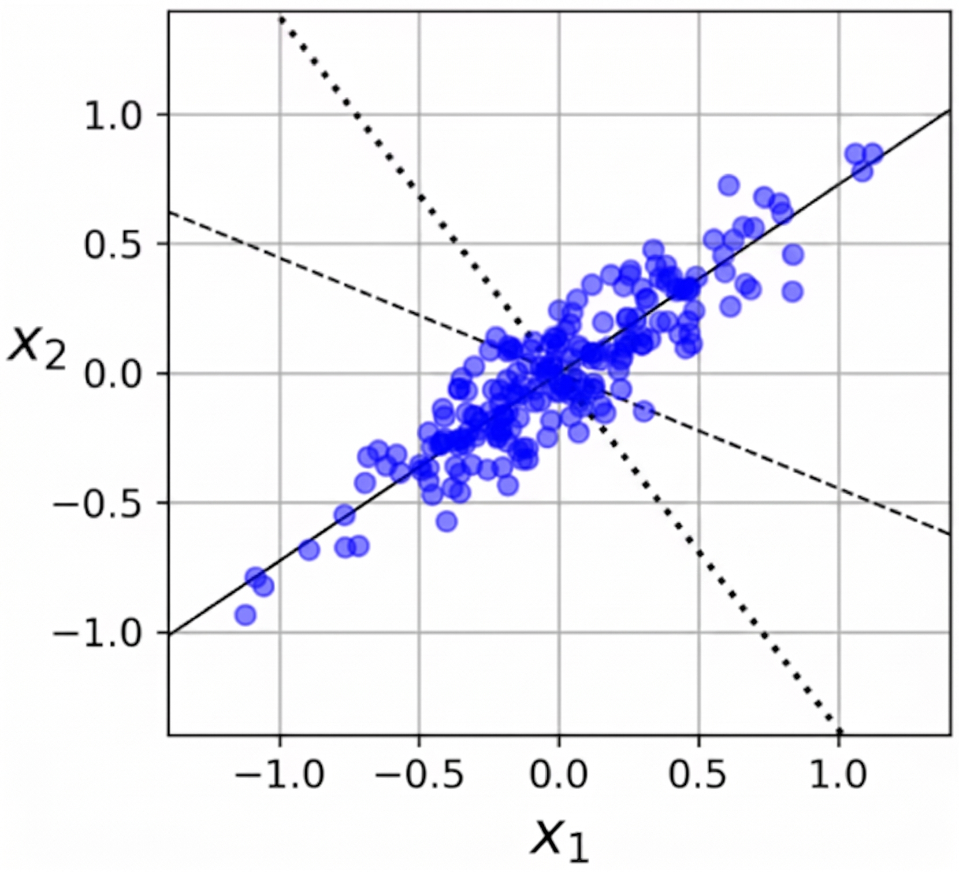
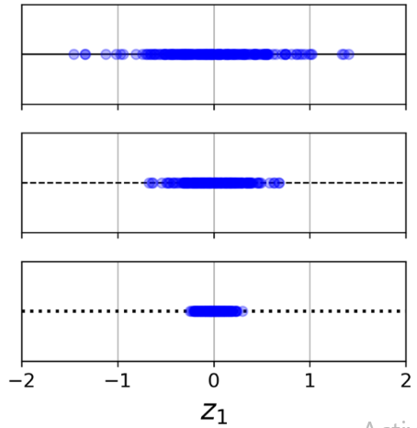



highest variance

Slide 28
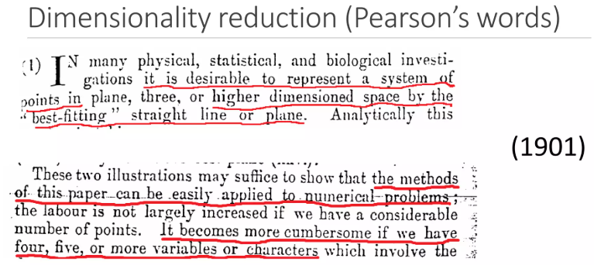
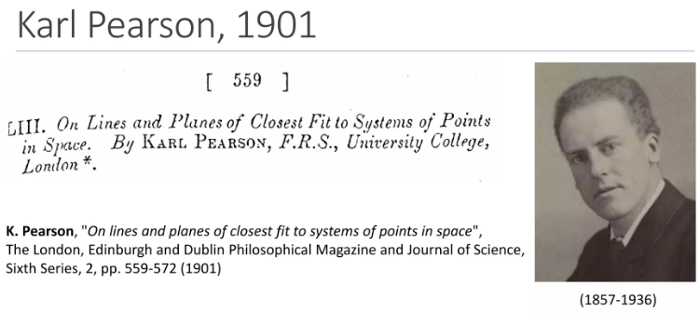
Fun fact: PCA was invented over 100 years ago — still one of the most used tools in AI today!

Slide 29
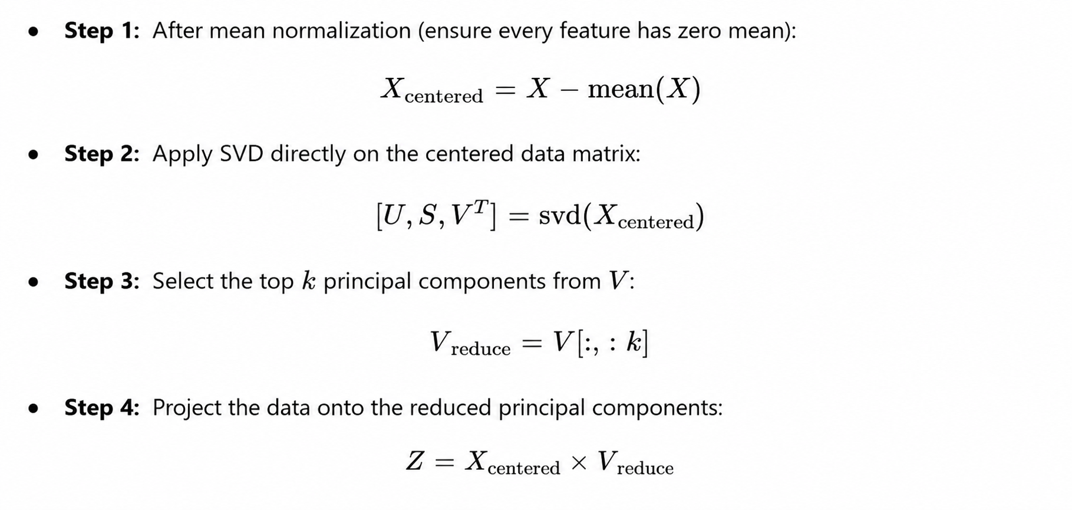




Slide 30


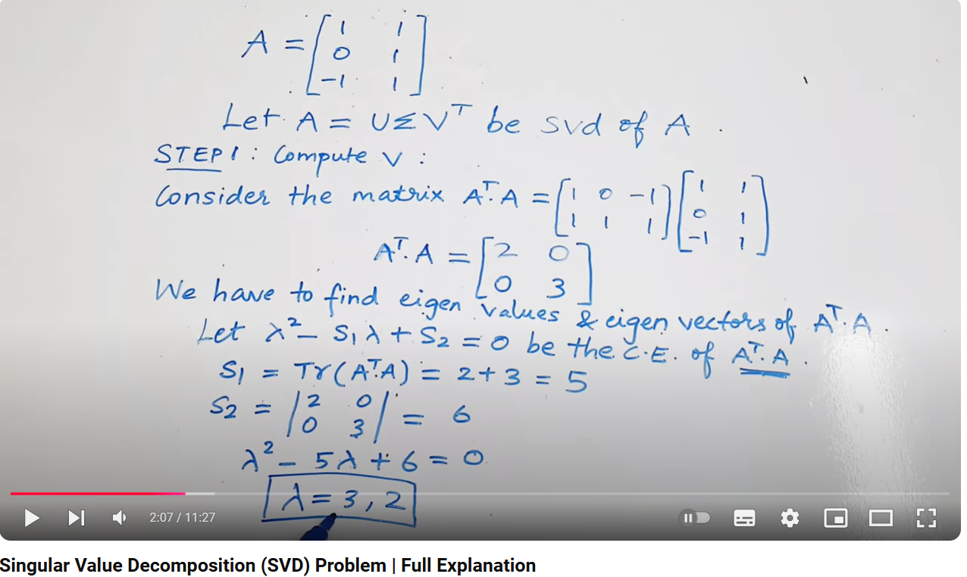

What is SVD?
https://medium.com/intuition/singular-value-decomposition-svd-working-example-c2b6135673b5

Slide 31
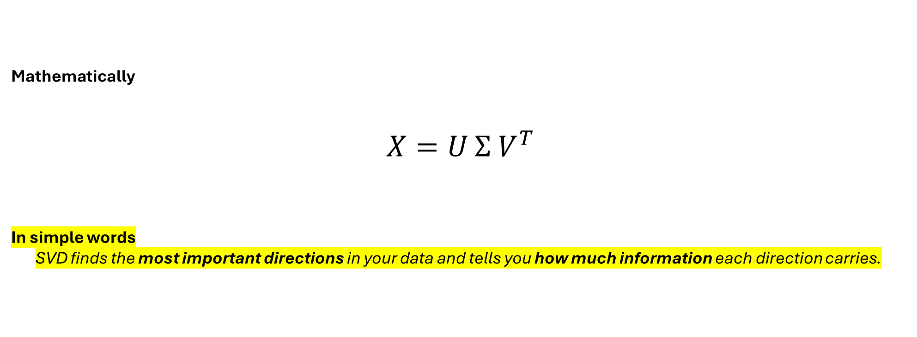
What SVD Really Does (Intuition)
https://gregorygundersen.com/blog/2018/12/10/svd/
Mathematically
$$X=U Σ V^{T}$$
In simple words
SVD finds the most important directions in your data and tells you how much information each direction carries.

Slide 32


Slide 33


Slide 34

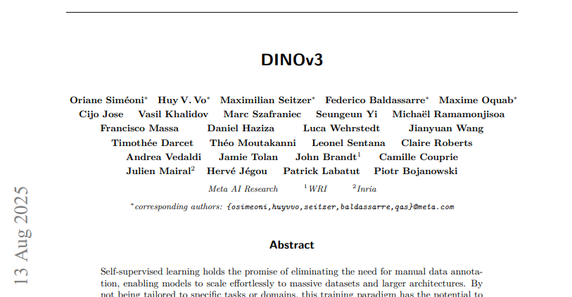
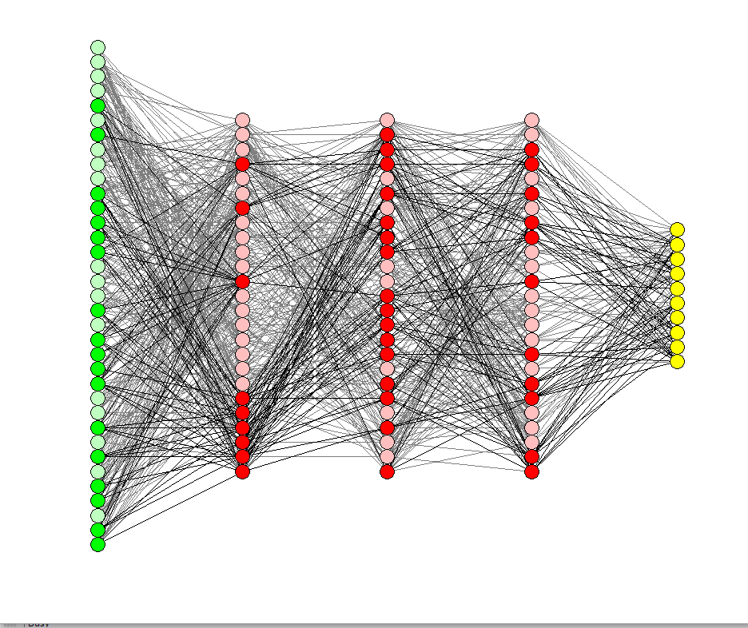

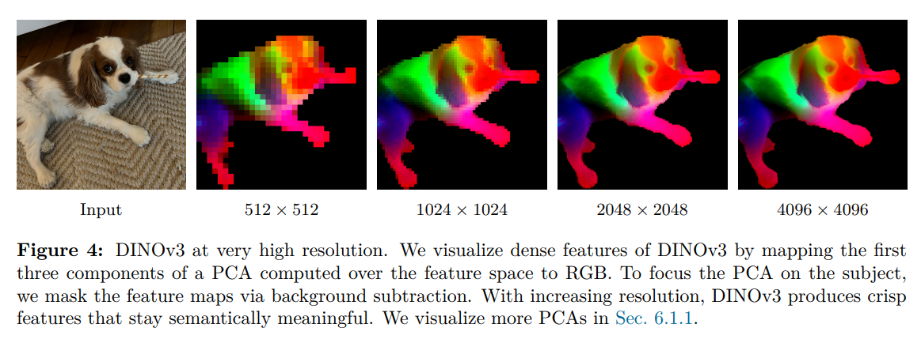
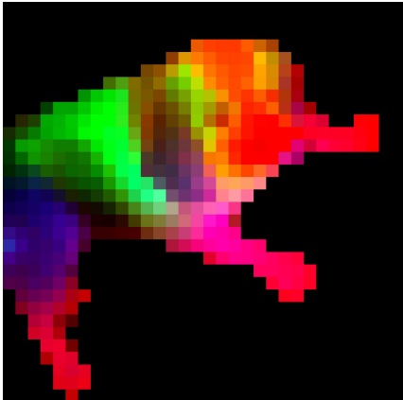


512
512
Some complicated model developed by
n elements (e.g. 2048)
Each pixel is encoded by a multidimensional vector:
…
PCA
3 elements

Slide 35
DINOv3 is a new special self-supervised model that learns image features without labels released by Meta
Each pixel in the image has a feature vector (hundreds of values) describing what the model “sees”
These feature vectors live in a high-dimensional space — impossible to visualize directly
PCA reduces these high-dimensional pixel features to just 3 components
The 3 principal components are mapped to RGB colors
Similar colors = pixels that the network considers semantically similar
This lets us see how the model internally organizes the image
PCA makes the model’s feature space visible —
it helps researchers interpret, debug, and trust how AI “understands” images.

Slide 36
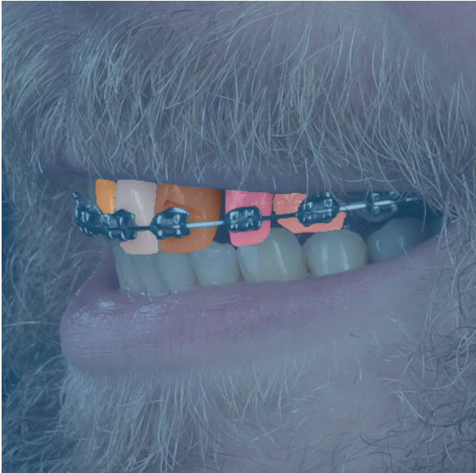
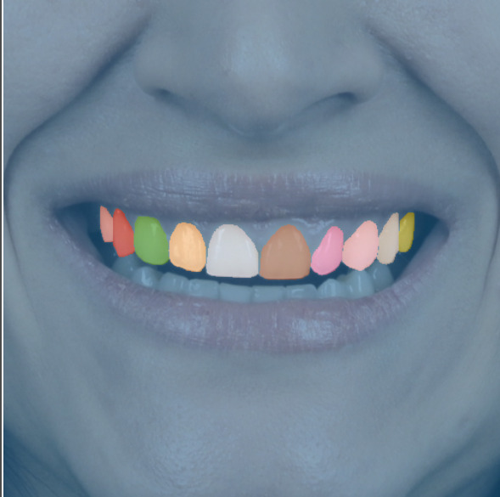
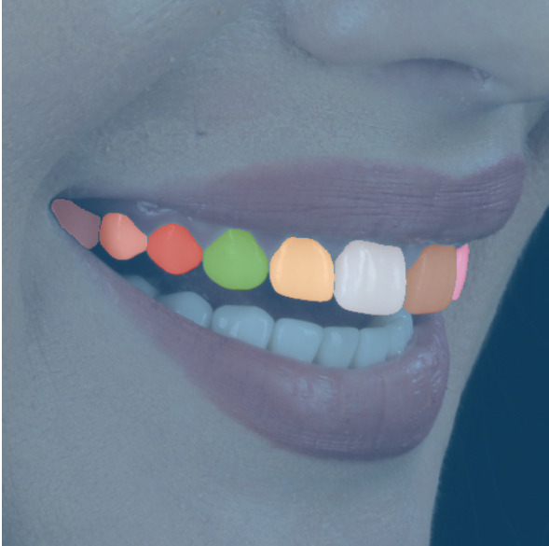

At Smilecloud, we leverage DINOv3 to segment teeth in smile images.
Each pixel in the image has a high-dimensional feature vector that encodes semantic meaning.
Using PCA, we can project these features into 3D RGB space to visualize what DINO “understands” about the image.
Left & Middle: DINO correctly segments individual teeth with distinct PCA colors.
Right: Remarkably, tooth 16 (unlabeled in the ground truth) is still detected by DINO —
PCA visualization exposes that the model internally recognizes this tooth region.

Slide 37
Code part

Slide 38
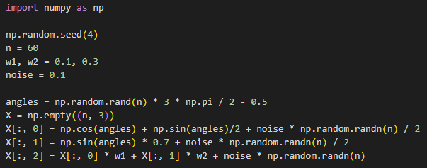
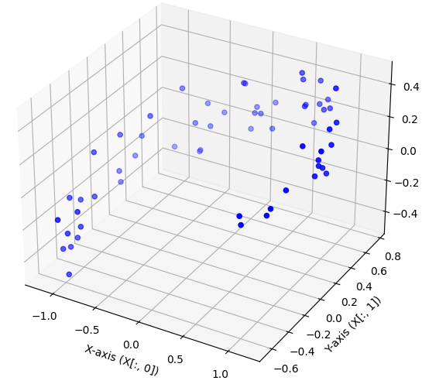
Our 3D dataset:
Z-axis (X[:, 2])

Slide 39


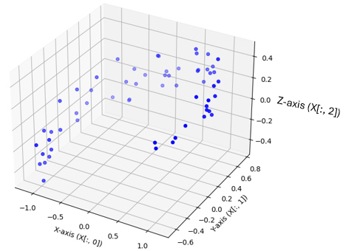
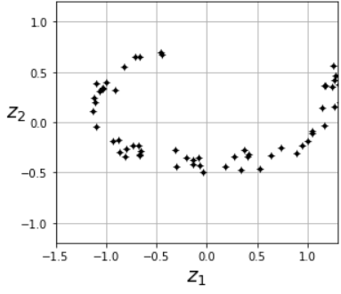
mean normalization:
apply SVD (single value decomposition):
select the top 2 principal components :
obtain the reduced dataset:
X
X2D_using_svd

Slide 40



…or in a simpler way…
the same with previous X2D_using_svd
this is how we can see the components computed by PCA:

Slide 41


^
we can transform the data back to the original space, obtaining X:
of course, there was some loss of information during the projection step, so the recovered 3D points are not exactly equal to the original 3D points:
reconstruction error

Slide 42





X_train
X_recovered
plot_digits() function from the lab

Slide 43
3) Locally linear embedding (LLE)

Slide 44

Swiss roll dataset
Unroleld Swiss roll
it’s a manifold learning algorithm it’s used for datasets like Swiss roll
in a nutshell, LLE works by:
      1) measuring how each training instance linearly relates to it closest neighbors
      2) looking for a low-dimensional representation of the training set where these local relationships are best preserved

Slide 45


Don’t worry about it ☺

Slide 46
Code part

Slide 47




Slide 48




don’t worry about them ☺
KIND REMINDER

Slide 49
4) t-Distributed stochastic neighbor embedding (t-SNE)

Slide 50


Slide 51

t-SNE reduces dimensionality while trying to keep similar instances close and dissimilar instances apart
ideal for visualizing high-dimensional clusters

Slide 52



Again, don’t worry about it ☺

Slide 53
Code part

Slide 55




Slide 56




Slide 57






PCA
t-SNE

Slide 58
Conclusion from the previous slide?
t-SNE reduces dimensionality while also helps for clustering !

Slide 60


Slide 61
Exercises

Slide 62


Slide 63
Big picture first, details last

Slide 64





Solutions

Slide 65



Slide 66




Slide 67



Slide 68


Slide 69
Thank you !

